Slide 1
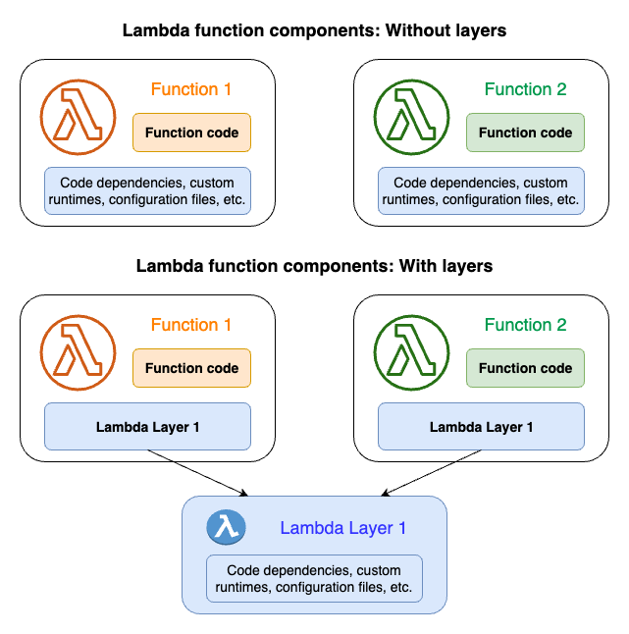

Slide 2
You can configure your Lambda function to use additional code and content in the form of layers. A layer is a ZIP archive that contains libraries, a custom runtime, or other dependencies. With layers, you can use libraries in your function without needing to include them in your deployment package.
If your Lambda function includes layers, Lambda extracts the layer contents into the /opt directory in the function execution environment. Lambda extracts the layers in the order that you added them to the function. If the same file appears in multiple layers, the function uses the version in the last extracted layer.
You can use the Merge earlier and Merge later buttons to adjust the merge order of the layers.
You can update the layer version by entering a new version in Layer version.
You can update the layer version that your functions use by selecting the functions you want to update from Functions using this version. Layer version updates will apply to the functions listed on this page.

Slide 3
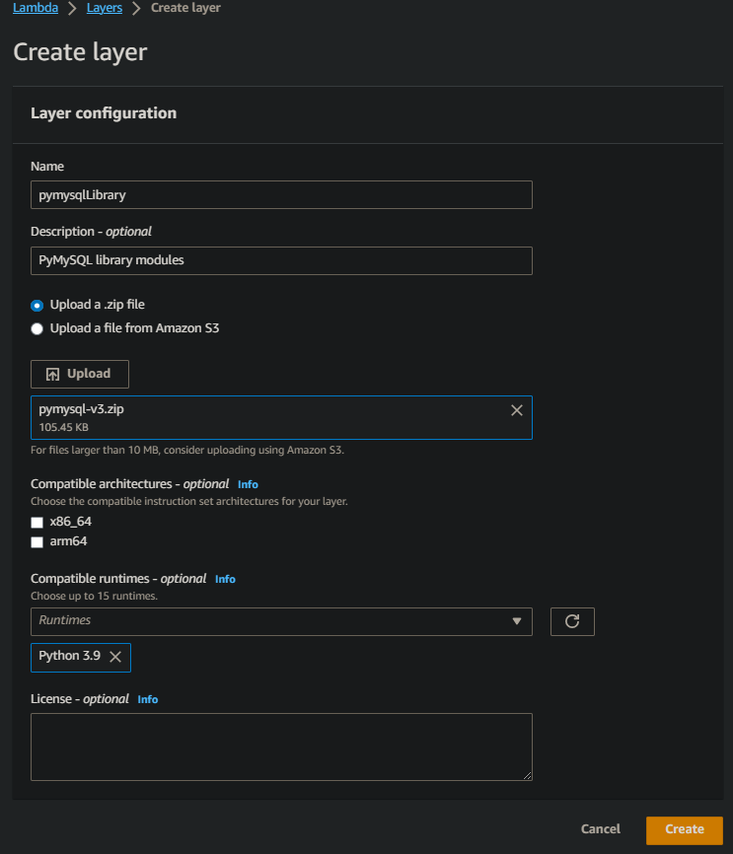
A Lambda layer is a .zip file archive that contains supplementary code or data. Layers usually contain library dependencies, a custom runtime, or configuration files.
This section explains how to create and delete layers in Lambda. For more conceptual information about layers and why you might consider using them, see Working with Lambda layers.
After you’ve packaged your layer content, the next step is to create the layer in Lambda. This section demonstrates how to create and delete layers using the Lambda console or the Lambda API only. To create a layer using AWS CloudFormation, see Using AWS CloudFormation with layers. To create a layer using the AWS Serverless Application Model (AWS SAM), see Using AWS SAM with layers.

Slide 4
Lambda supports multiple languages through the use of runtimes. A runtime provides a language-specific environment that relays invocation events, context information, and responses between Lambda and the function. You can use runtimes that Lambda provides, or build your own.
Each major programming language release has a separate runtime, with a unique runtime identifier, such as python3.10 or nodejs18.x. To configure a function to use a new major language version, you need to change the runtime identifier. Since AWS Lambda cannot guarantee backward compatibility between major versions, this is a customer-driven operation.

Slide 5
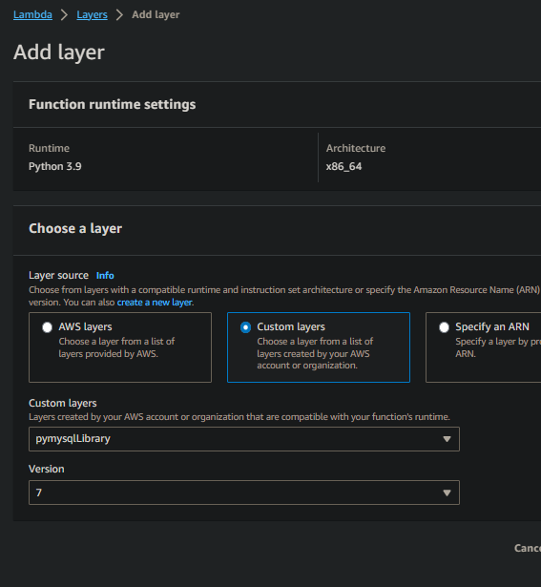
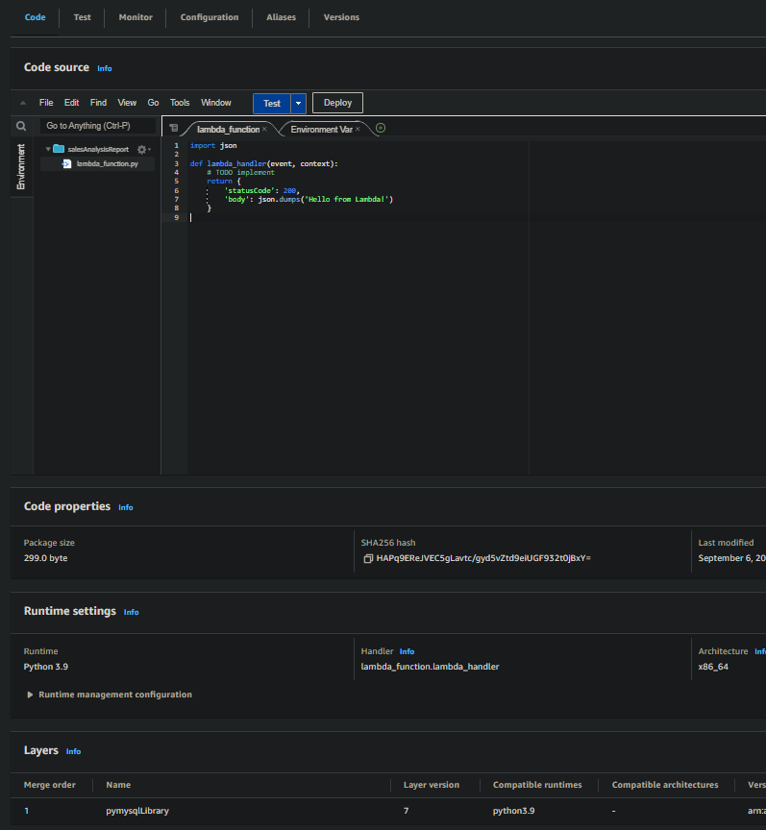

Slide 6
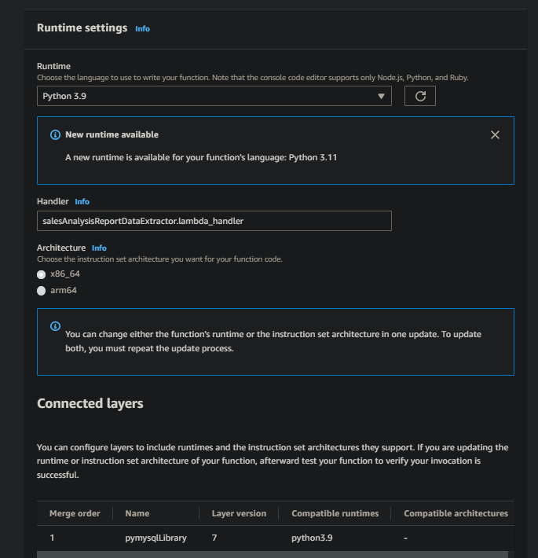
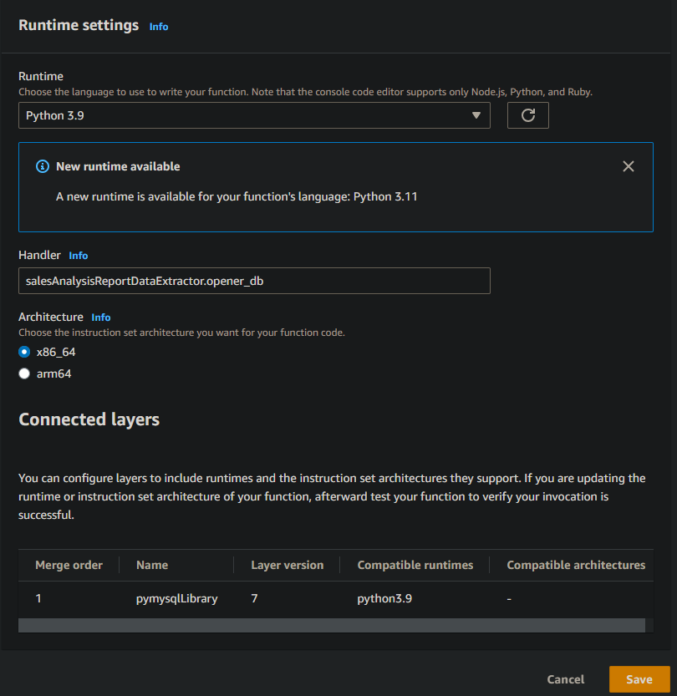

Slide 7
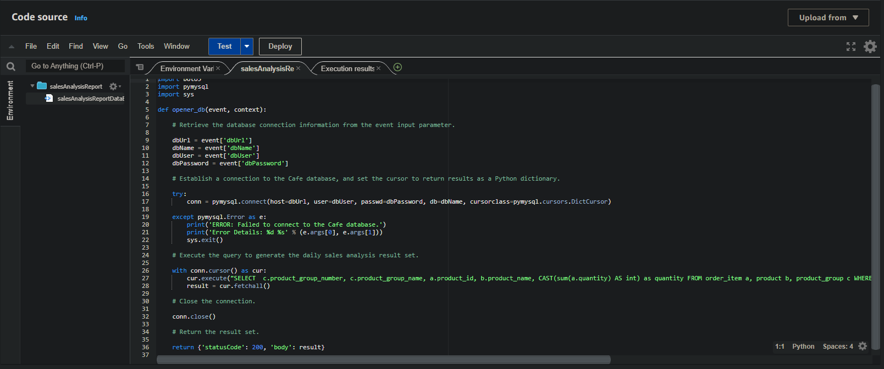

Slide 8
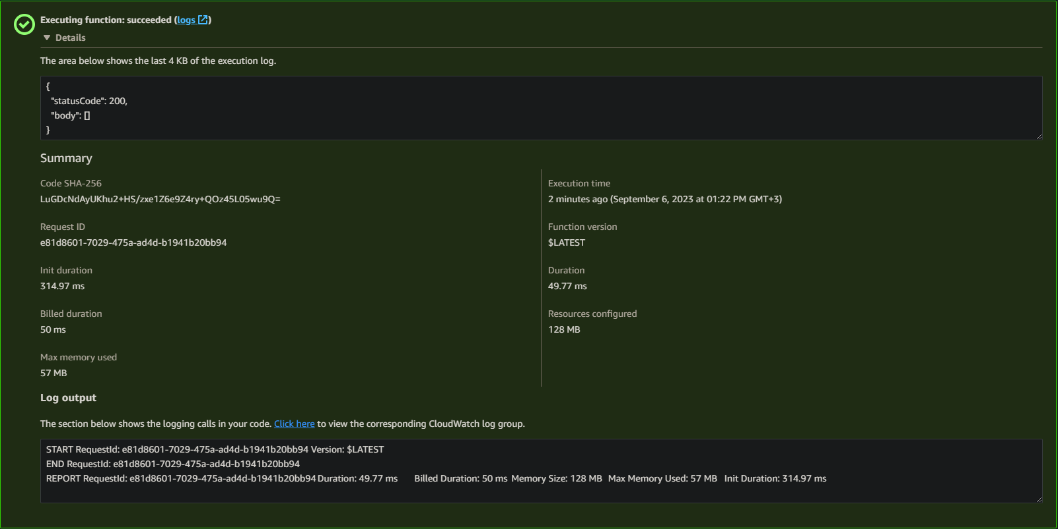

Slide 9
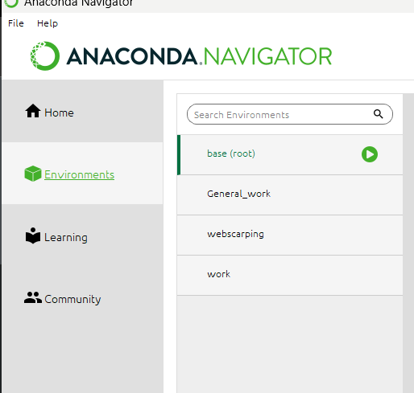
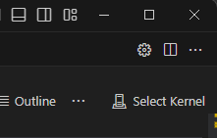
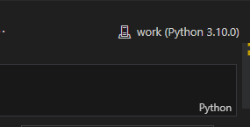

Slide 10

Beni dinlediğiniz için teşekkür ederim.
Hüseyin IŞIK

Slide 11
Kaynakça
https://docs.aws.amazon.com/lambda/latest/dg/chapter-layers.html?icmpid=docs_lambda_help
https://docs.aws.amazon.com/lambda/latest/dg/lambda-runtimes.html
https://docs.aws.amazon.com/lambda/latest/dg/python-handler.html?icmpid=docs_lambda_help
https://ipython.org/ipython-doc/3/development/kernels.html#:~:text=A%20'kernel'%20is%20a%20program,up%20communications%20with%20the%20frontend.
https://docs.jupyter.org/en/latest/projects/kernels.html
https://code.visualstudio.com/docs/datascience/jupyter-kernel-management
https://github.com/awsdocs/aws-lambda-developer-guide/tree/main/sample-apps/blank-python
https://docs.python.org/3/library/venv.html
https://www.freecodecamp.org/news/why-you-need-python-environments-and-how-to-manage-them-with-conda-85f155f4353c/
https://conda.io/projects/conda/en/latest/user-guide/tasks/manage-environments.html#activating-an-environment
https://docs.aws.amazon.com/lambda/latest/dg/configuration-function-zip.html
https://docs.aws.amazon.com/lambda/latest/dg/python-context.html

